Slide 1
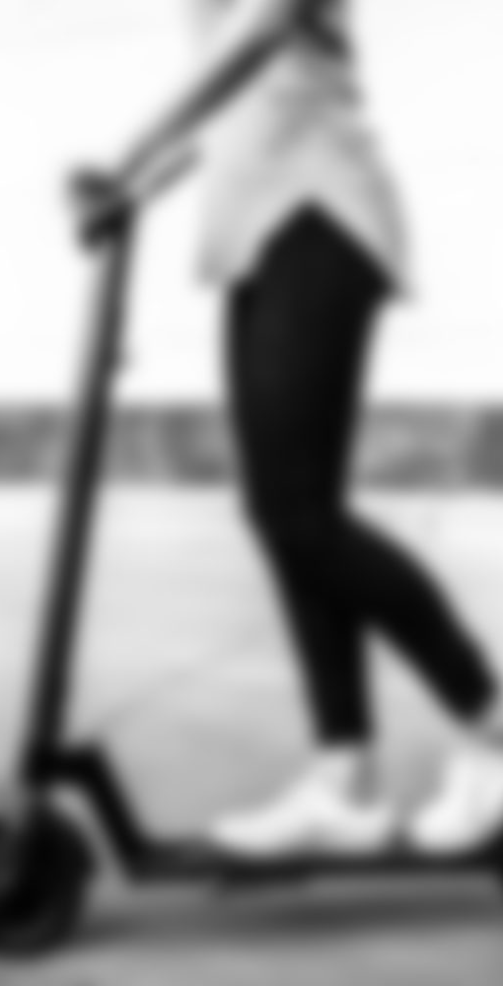
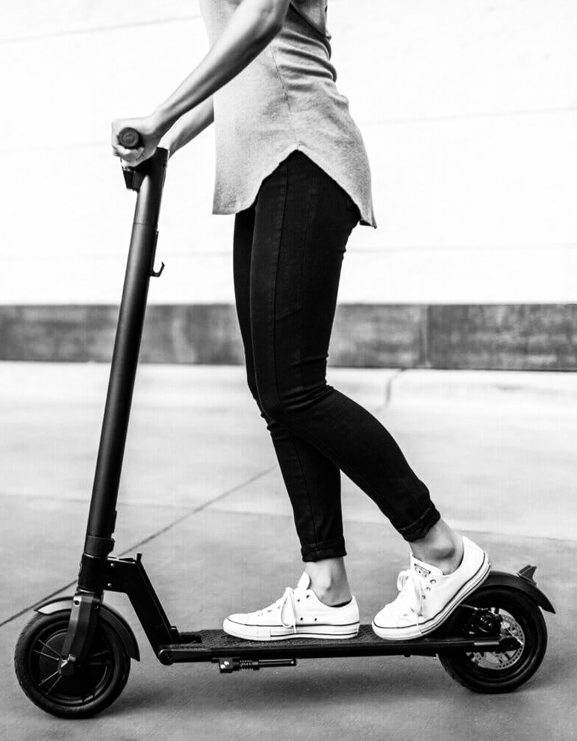
Shared Electric Scooter System
Pranathi Manusanipalli
Priyansha Sinha
Rishvita Reddy Bhumireddy
Ruoran Cheng
Stanny Lemos

Slide 2

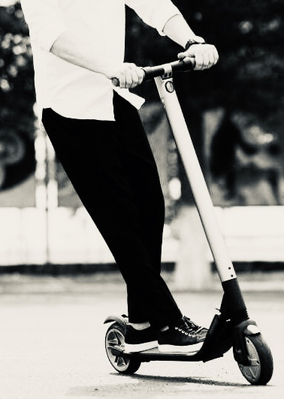
Mission Statement
To create a database system for the operations of a shared electric scooter business model

Slide 3

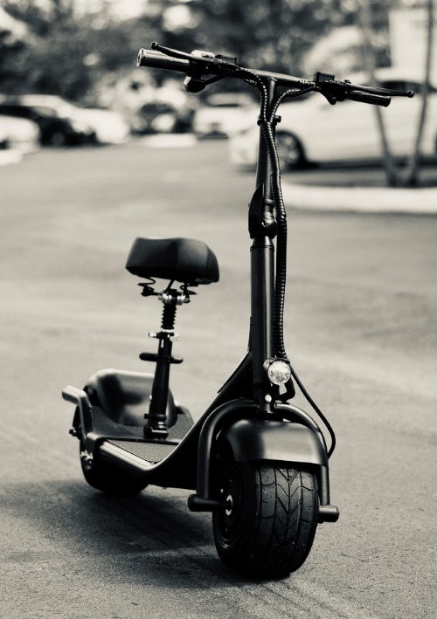
Mission Objectives
Create a reliable system to provide support for a shared scooter application
To have an efficient system that helps to manage the operations and logistics of the business
To collect significant scooter network data which will allow the company to make strategic business decisions

Slide 4

Design Summary
Scooter Rentals
Docking Stations
User Accounts on Mobile App
Periodic Maintenance by Staff
Scope of Works

Slide 5
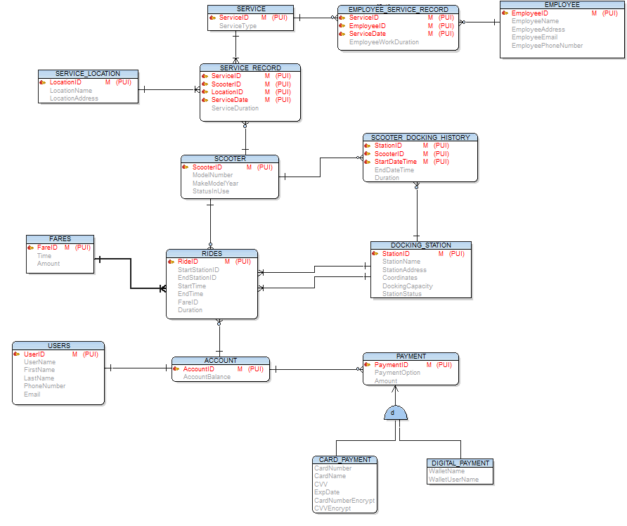
Final E-R Diagram

Slide 6
DDL Statements
SCOOTER
The SCOOTER entity records data about each scooter the organization owns and operates in the shared system
CREATE TABLE Ride
(
Ride_id INT IDENTITY(1,1),
Start_Station_Id VARCHAR(25),
End_Station_Id VARCHAR(25),
Start_Time DATETIME,
End_Time DATETIME,
Scooter_Id BIGINT NOT NULL,
Account_Id VARCHAR(25) NOT NULL,
Fare_id as dbo.fare_calculation(dbo.duration_calculation(Start_Time,End_Time)),
Duration AS dbo.duration_calculation(Start_Time,End_Time),
CONSTRAINT Ride_pk PRIMARY KEY (Ride_id),
CONSTRAINT Scooter_fk FOREIGN KEY (Scooter_Id) references Scooter(Scooter_Id),
CONSTRAINT Start_station_fk FOREIGN KEY (Start_Station_ID) references Docking_Station(Station_Id),
CONSTRAINT End_station_fk FOREIGN KEY (End_Station_ID) references Docking_Station(Station_Id),
CONSTRAINT account_id_fk FOREIGN KEY (Account_id) references Account(Account_Id)
);
DOCKING STATIONS
CREATE TABLE Scooter
(
Scooter_id BIGINT IDENTITY(10000,1),
ModelNumber VARCHAR(50),
Make_Model_Year INTEGER ,
Status_in_Use VARCHAR (1),
CONSRTAINT Scooter_pk PRIMARY KEY (Scooter_id),
CONSRTAINT ModelNumber_chk CHECK (substring(ModelNumber,1,1)='B' and isnumeric(substring(ModelNumber,2,len(ModelNumber)))!=0 and len(ModelNumber)>=5) ,
CONSRTAINT status_chk CHECK (Status_in_Use in ('Y','N'))
);
The DOCKING STATIONS entity records data of all the docking stations located within the city
CREATE TABLE Docking_Station
(
Station_ID VARCHAR (25),
Station_Name VARCHAR (255),
Station_Address VARCHAR (255),
Coordinates GEOGRAPHY,
Docking_Capacity INTEGER ,
Station_Status VARCHAR(1)
CONSRTAINT Station_pk Primary key (Station_ID),
CONSRTAINT Station_Status_pk check (Station_Status in ('Y','N')),
CONSRTAINT StationId_chk check (substring(Station_ID,1,2)='DS' and isnumeric(substring(Station_ID,3,len(Station_ID)))!=0 and len(Station_ID)>=5)
);
CREATE TABLE Users
(
User_ID VARCHAR(25) NOT NULL,
Username VARCHAR(50),
First_Name VARCHAR(50),
Last_Name VARCHAR(50),
Phone_Number BIGINT UNIQUE,
Email VARCHAR(50),
CONSTRAINT Users_PK PRIMARY KEY(User_ID),
CONSTRAINT chk_userid CHECK (SUBSTRING(User_ID,1,1)='U' and ISNUMERIC(SUBSTRING(User_ID,2,LEN(User_ID)))!=0 and LEN(User_ID)>=5),
CONSTRAINT Users_Email CHECK(Email LIKE '%___@___%'),
CONSTRAINT phone_chk check(len(phone_number) =10)
);
CREATE TABLE Payment
(
payment_id VARCHAR(25) NOT NULL,
payment_option INT,
account_id VARCHAR(25) NOT NULL,
Amount MONEY NOT NULL,
CONSTRAINT payment_pk PRIMARY KEY (payment_id),
CONSTRAINT payment_fk FOREIGN KEY (account_id) REFERENCES Account (account_id),
CONSTRAINT chk_option CHECK (payment_option in (1,2))
);
USERS
USER Entity records the basic information about the user
RIDES
The RIDES entity records data of all the rides made by users
PAYMENT
The PAYMENT entity records data of the payments made by the user to his/her account
Entities
Notes:
PAYMENT-card or digital

Slide 7
DDL Statements
FARES
The FARES Entity records the data of the fares based on the time the user has rented the scooter.
CREATE TABLE Employee
(
employee_id VARCHAR(25) NOT NULL ,
employee_name VARCHAR(50) ,
employee_address VARCHAR(255),
employee_email VARCHAR(50),
employee_phone BIGINT,
CONSTRAINT chk_emp_id check(substring(employee_id,1,1)='E' and substring(employee_id, 2, len(employee_id)) like '%[0-9]%'
and len(employee_id) >=5),
CONSTRAINT chk_phn_no check(len(employee_phone) = 10 ),
CONSTRAINT chk_email check( employee_email like '%@%.%'),
CONSTRAINT pk_emp_id PRIMARY KEY (employee_id)
);
CREATE TABLE Fares
(
Fare_ID VARCHAR(25) NOT NULL,
[Time] INT NOT NULL,
Amount MONEY NOT NULL
CONSTRAINT Fares_PK PRIMARY KEY (Fare_ID),
CONSTRAINT chk_fareid CHECK (SUBSTRING(Fare_ID,1,1)='F' and ISNUMERIC(SUBSTRING(Fare_ID,2,LEN(Fare_ID)))!=0 and LEN(Fare_ID)>=5)
);
SERVICE
CREATE TABLE Service_Location
(
location_id VARCHAR(25) NOT NULL,
location_name VARCHAR(50),
location_address VARCHAR(255)
CONSTRAINTid_pk PRIMARY KEY (location_id),
CONSTRAINT chk_loc_id check(substring(location_id,1,2)='SL' and substring(location_id, 3, len(location_id)) like '%[0-9]%'
and len(location_id) >=5)
);
CREATE TABLE Service
(
Service_id VARCHAR(25) ,
Service_Type VARCHAR(50),
CONSTRAINT Service_pk PRIMARY KEY (Service_id),
CONSTRAINT ServiceId_chk CHECK (substring(Service_id,1,1)='S' and isnumeric(substring(Service_id,2,len(Service_id)))!=0 and len(Service_id)>=5)
);
The SERVICE entity records information about the type of services the scooter can be subjected to.
SERVICE LOCATION
The SERVICE LOCATION entity records data about the service provided to the scooter.
EMPLOYEES
The EMPLOYEES entity records the basic information about the employees
Entities

Slide 8
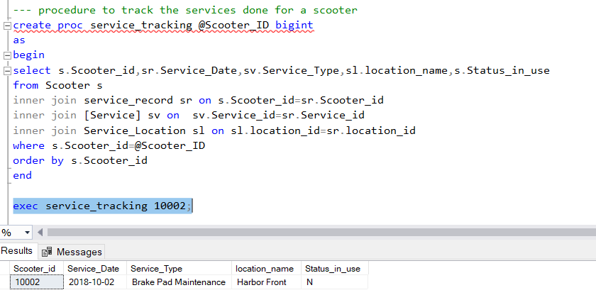
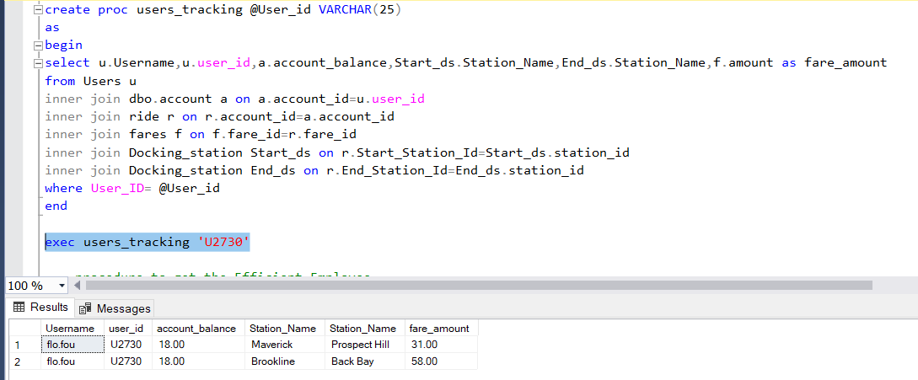
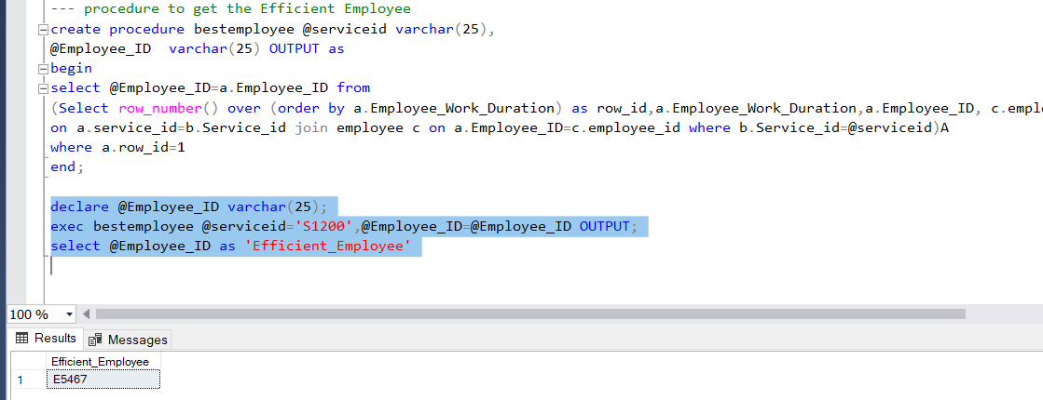
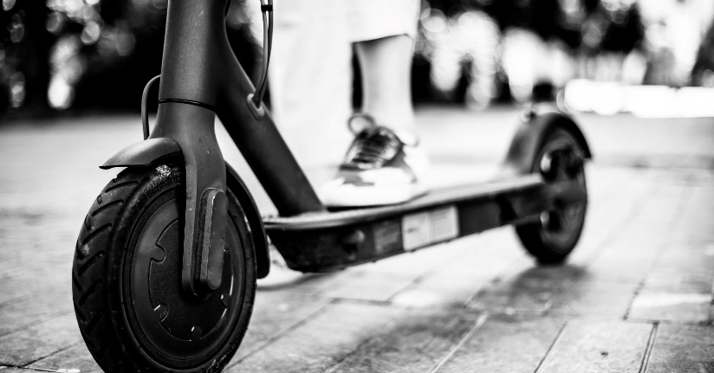
Stored Procedures
TRACK SERVICES
Shows the service history for a specified scooter.
TRACK RIDES
Shows information regarding a user and the number of rides they have taken.
FIND EFFICIENT EMPLOYEE
Gives details about the most efficient employee with respect to service type.

Slide 9
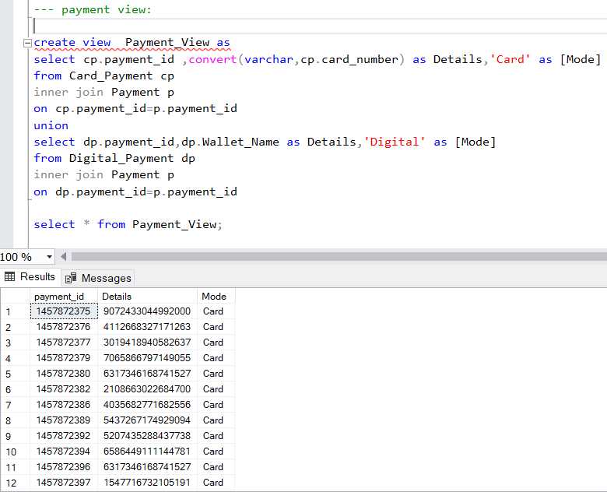
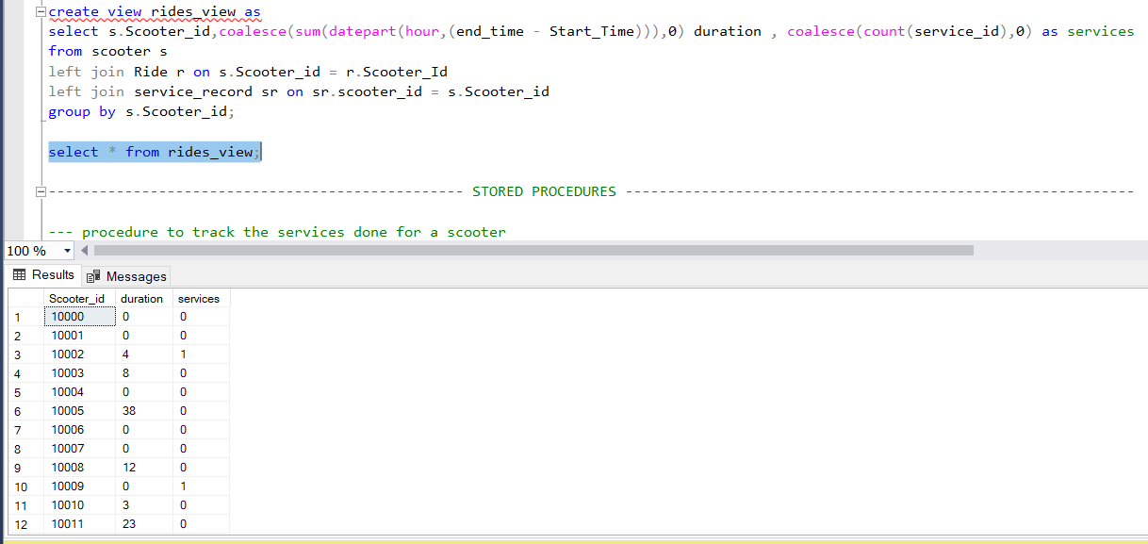
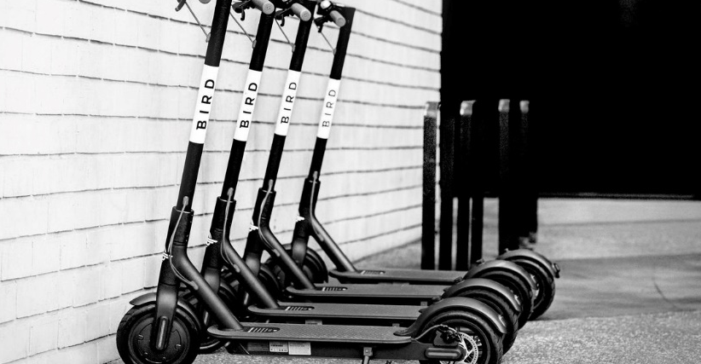
Views
PAYMENT
Gives details regarding mode of payment showing Card Details or Digital ID.
SCOOTER RIDES / SERVICES
Gives details of all scooters with respect to ride durations and total services it has undergone.

Slide 10
Triggers
WHEN USER DELETED FROM ‘USER’ TABLE, CORRESPONDING ACCOUNT DELETED
WHEN PAYMENT TABLE UPDATED, TRANSACTION IS ADDED TO CORRESPONDING ACCOUNT
CREATE TRIGGER Account_delete ON dbo.users
FOR DELETE
AS
BEGIN
DELETE FROM dbo.Account WHERE Account_ID=(SELECT i.User_ID FROM deleted i)
END
CREATE TRIGGER dbo.amount_update ON dbo.payment
FOR INSERT
AS
BEGIN
UPDATE account
SET account_balance = sum_amount
FROM account a JOIN
(SELECT account_id , SUM(amount) sum_amount
FROM payment GROUP BY account_id) t
ON a.account_id = t.account_id
END

Slide 11
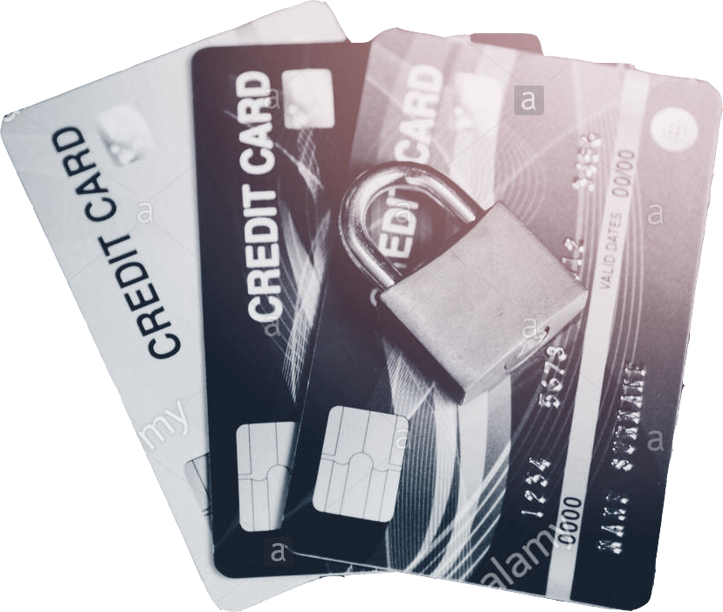
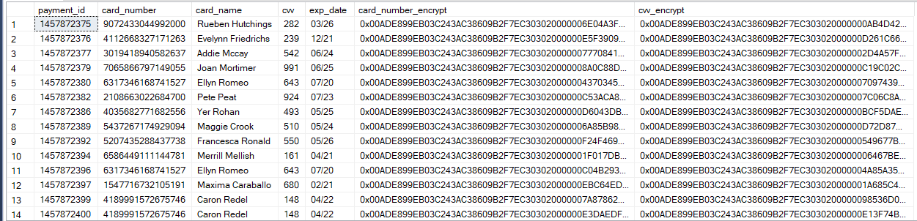
---check for master key
USE master;
GO
SELECT *
FROM sys.symmetric_keys
WHERE name = '##MS_ServiceMasterKey##';
GO
---creating key for project
USE project;
GO
CREATE MASTER KEY ENCRYPTION BY PASSWORD = 'Password123';
GO
--creating certificate
CREATE CERTIFICATE Certificate1
WITH SUBJECT = 'Protect Data';
--creating key
CREATE SYMMETRIC KEY SymmetricKey1
WITH ALGORITHM = AES_128
ENCRYPTION BY CERTIFICATE Certificate1;
--encrypt card_number
ALTER TABLE Card_Payment ADD card_number_encrypt varbinary(MAX) NULL
OPEN SYMMETRIC KEY SymmetricKey1
DECRYPTION BY CERTIFICATE Certificate1;
GO
UPDATE Card_Payment
SET card_number_encrypt = EncryptByKey (Key_GUID('SymmetricKey1'),card_number)
FROM dbo.Card_Payment;
GO
-- Closes the symmetric key
CLOSE SYMMETRIC KEY SymmetricKey1;
--display card_number values
OPEN SYMMETRIC KEY SymmetricKey1
DECRYPTION BY CERTIFICATE Certificate1;
GO
SELECT card_number_encrypt AS 'Encrypted Card Num',
CONVERT(varchar, DecryptByKey(card_number_encrypt)) AS 'Decrypted Card Number' from Card_Payment
CLOSE SYMMETRIC KEY SymmetricKey1;
--encrypt cvv
ALTER TABLE Card_Payment ADD cvv_encrypt varbinary(MAX) NULL
OPEN SYMMETRIC KEY SymmetricKey1
DECRYPTION BY CERTIFICATE Certificate1;
GO
UPDATE Card_Payment
SET cvv_encrypt = EncryptByKey (Key_GUID('SymmetricKey1'),CONVERT(varchar,cvv))
FROM dbo.Card_Payment;
GO
-- Closes the symmetric key
CLOSE SYMMETRIC KEY SymmetricKey1;
--encrypt cvv
ALTER TABLE Card_Payment ADD cvv_encrypt varbinary(MAX) NULL
OPEN SYMMETRIC KEY SymmetricKey1
DECRYPTION BY CERTIFICATE Certificate1;
GO
UPDATE Card_Payment
SET cvv_encrypt = EncryptByKey (Key_GUID('SymmetricKey1'),CONVERT(varchar,cvv))
FROM dbo.Card_Payment;
GO
-- Closes the symmetric key
CLOSE SYMMETRIC KEY SymmetricKey1;
Encrypted Card and CVV Numbers
Encryption

Slide 12
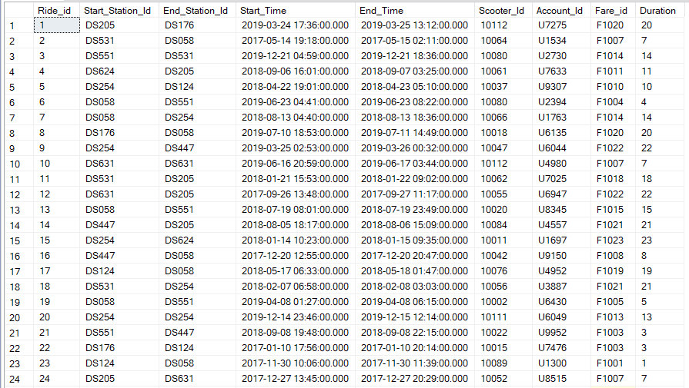
Ride TABLE
Data Population

Slide 13

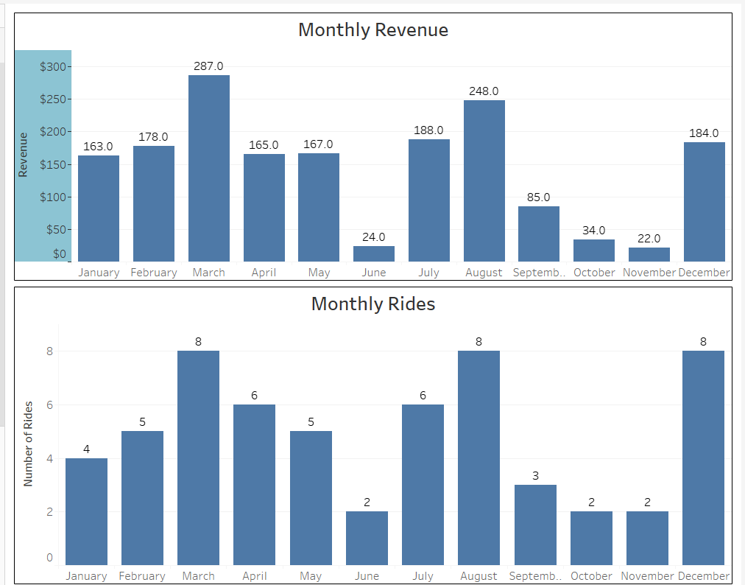
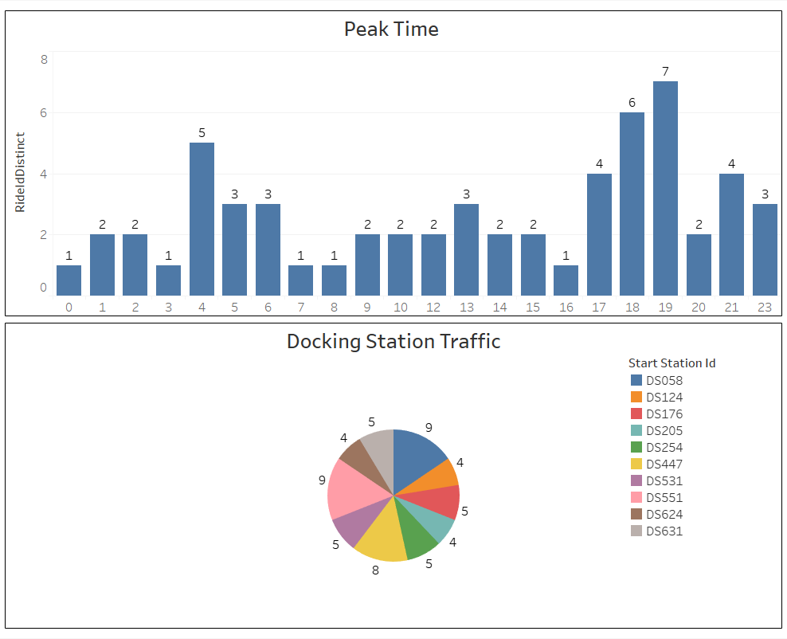
Reports

Slide 14

Graphical User Interface Demo

